Slide 1

CSE1021- Problem Solving and Programming

Slide 2
UNIT IV PYTHON
Factoring Methods: Finding square root – Smallest Divisor – GCD – Generate Prime Numbers – Computing Prime Factors – Generating Pseudo-random numbers – Raising a Number to Large Power – Computing nth Fibonacci Numbers

Slide 3
Factorization
What is factorization?
Factors of a number are numbers that divide evenly into another number.
Factorization writes a number as the product of smaller numbers.
For example, let’s factor the number 12:
12 = 6 x 2 or
12 = 3 x 4 or
12 = 2 x 2 x 3

Slide 4
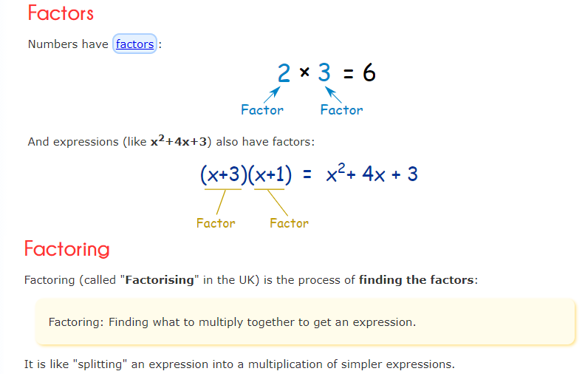
Factoring Method - Introduction

Slide 5
Problem: Finding Square Root by Using Factoring Method
Square root of a positive number is identified by using,
Prime Factorization
(used only for perfect square numbers)
Long Division
(used for both perfect and imperfect square numbers)

Slide 6
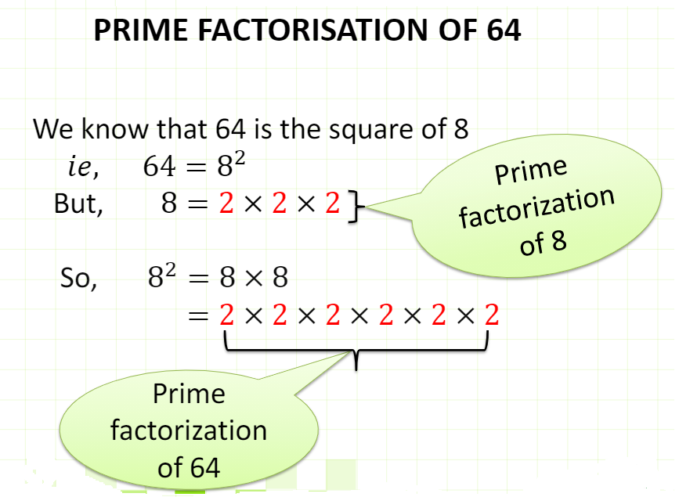
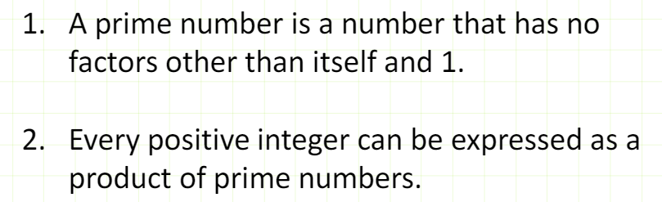
Prime Factorization

Slide 7
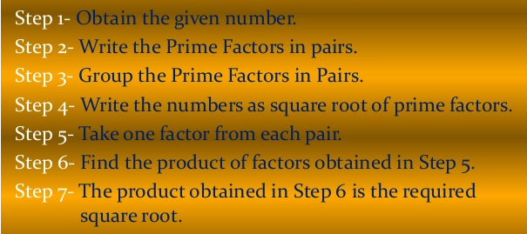
i. Finding a Square Root by Prime Factorization

Slide 8
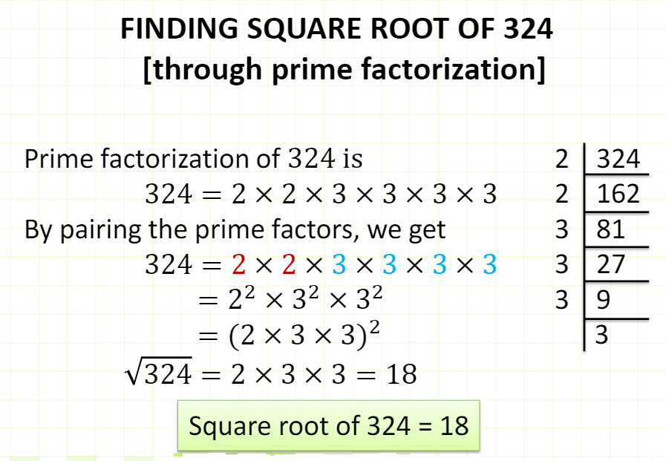

Slide 9
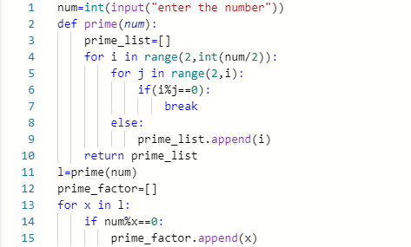
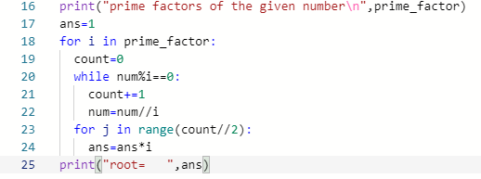

Finding a perfect Square Root – using prime factorization
OUTPUT:

Slide 10
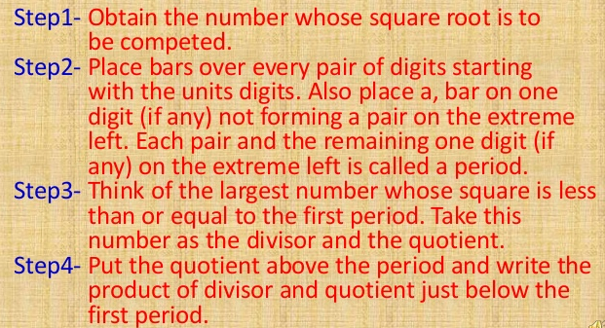
ii. Finding a Square Root by Long Division

Slide 11
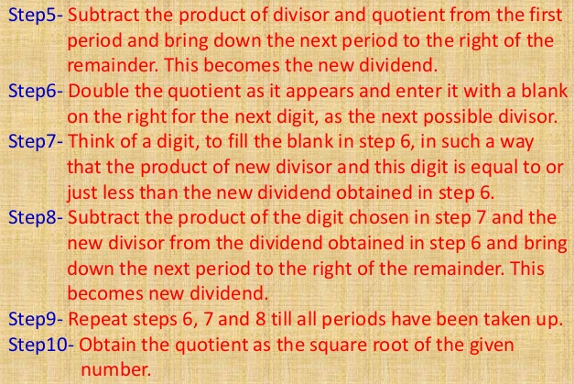
Finding a Square Root by Long Division

Slide 12
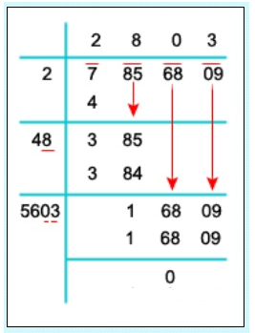
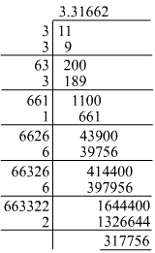
Finding a Square Root by Long Division

Slide 13
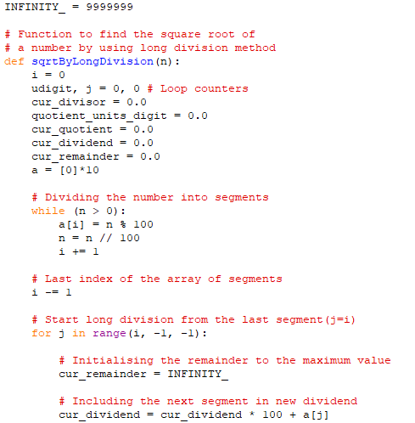

Slide 14
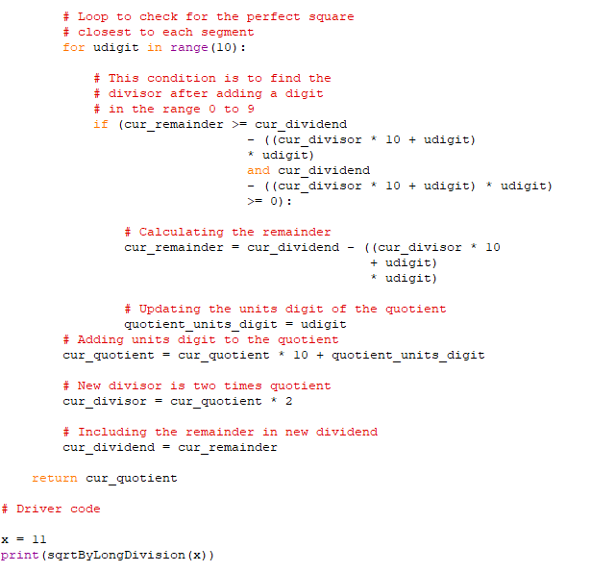

Slide 15
Finding a Square Root
Using math.sqrt()
Using pow()
Using exponent operator
Using Newton’s Method
Using Repeated Subtraction
Using Long Division
Using Prime Factorization
- (suitable, only for perfect square number)

Slide 16
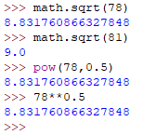
Finding a Square Root – using Built-in Concept
sqrt(x)
Parameter: x is any number such that x>=0
Returns: It returns the square root of the number passed in the parameter.
pow(x,y,z) →(x^{y})%z
Parameter: x → number, the base, y→ number, the exponent,
z (optional)→ number, the modulus
Exponent Operator (‘**’) → raise the number on the left to the power of the exponent of the right. (e.g., 5**2 →5²)

Slide 17

Newton’s Method for Square Root
The square root of a positive number b can be computed with Newton's formula:
where x above starts with a "reasonable" guess. In fact, you can always start with b or some other value, say 1.
With b and a guess value x, a new guess value is computed with the above formula.
This process continues until the new guess value and the current guess value are very close.

Slide 18
Newton’s Method for Square Root
root = 0.5 * (X + (N / X))
where X is any guess which can be assumed to be N or 1.
Algorithm:
Step 1: Start
Step 2: Assign X to the N itself.
Step 3: Now, start a loop and keep calculating the root which will surely move towards the correct square root of N.
Step 4: Check for the difference between the assumed X and calculated root, if not yet inside tolerance then update root and continue Step 3 else go to step 5.
Step 5: Print the root.
Step 6: End

Slide 19
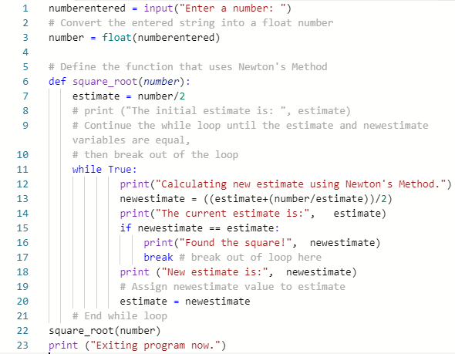
Program: Newton’s Square Root

Slide 20
Problem: Finding Smallest Divisor Using Factoring Method
Approach:
Check if the number is divisible by 2 or not if so, return 2.
Iterate from i = 3 to sqrt(N) and making a jump of 2.
If any of the numbers divide N then it is the smallest prime divisor.
If none of them divide, then N is the answer.

Slide 21
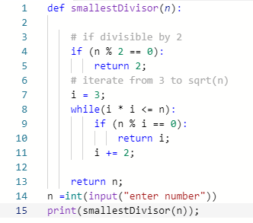
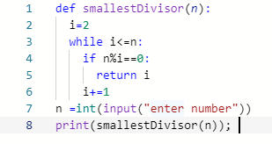
Smallest Divisor of a Number

Slide 22
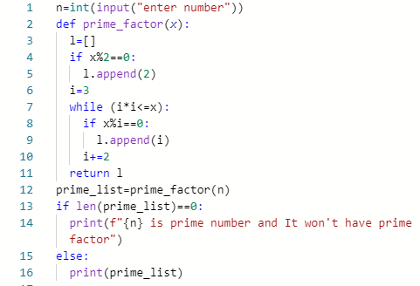
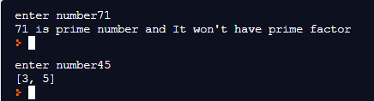
Generating Prime Factors of a Number

Slide 23
Problem: Finding Greatest Common Divisor (GCD)
Approach:
Prime Factorization
Repeated Division
Euclidean Method

Slide 24
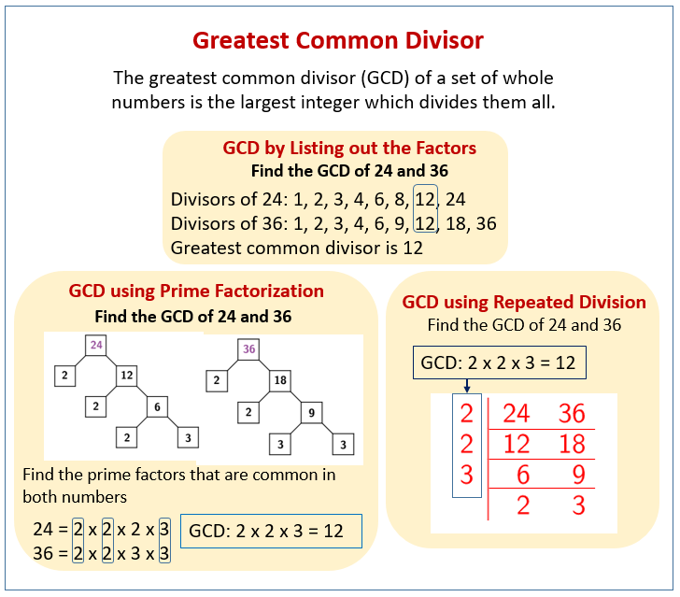

Slide 25
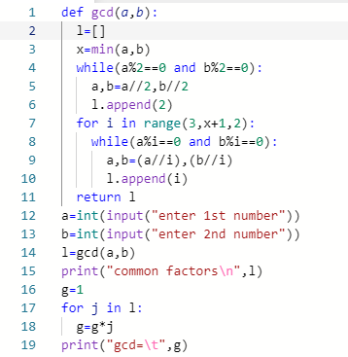
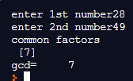
GCD Using Repeated Division

Slide 26
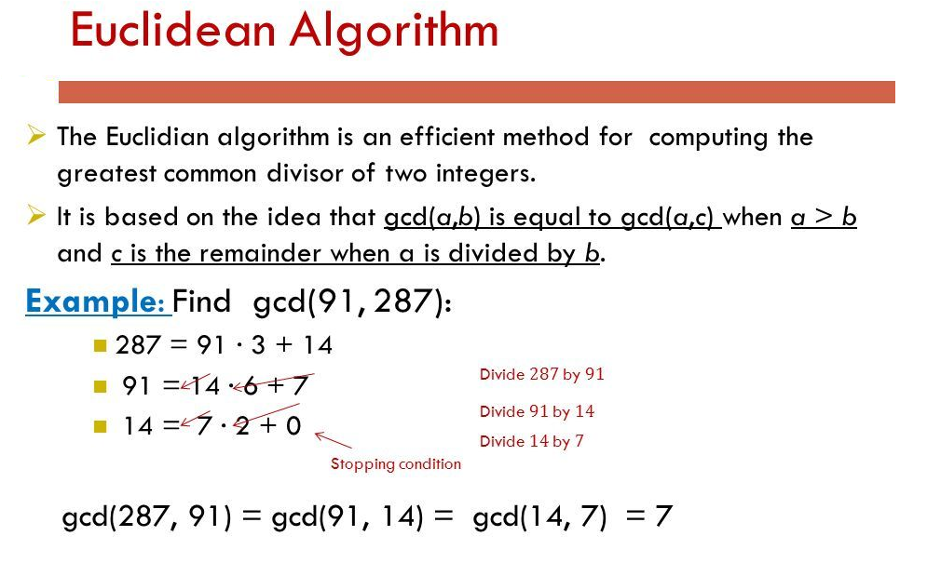

Slide 27
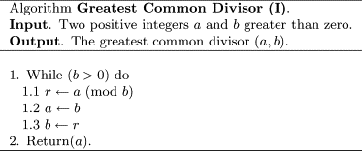
GCD Using Euclidean Method

Slide 28
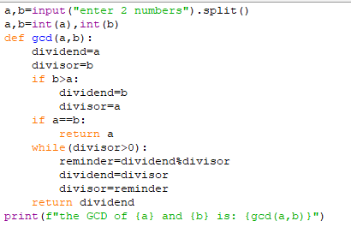
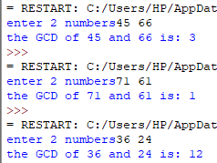
GCD Using Euclidean Method

Slide 29
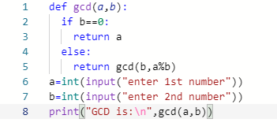
GCD Using Recursion
Example:1
Gcd(63,22) → return 1
Gcd(22,19) → return 1
Gcd(19,3)→ return 1
Gcd(3,1)→return 1
Gcd(1,0)
B==0
return a=1
Example: 2
Gcd(48,64)
Gcd(64,48)
Gcd(48,16)
Gcd(16,0)
B==0
return a=16

Slide 30
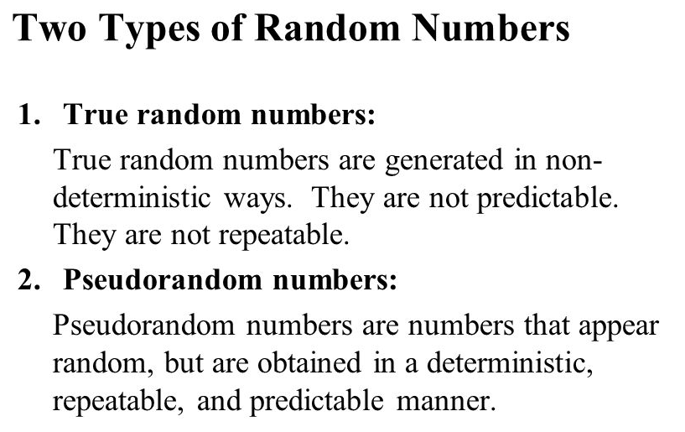
Generating Pseudo Random Number

Slide 31
Generating Pseudo Random Number
Pseudo Random Number Generator(PRNG) refers to an algorithm that uses mathematical formulas to produce sequences of random numbers.
A PRNG starts from an arbitrary starting state using a seed state.
Characteristics of PRNG
Efficient: PRNG can produce many numbers in a short time and is advantageous for applications that need many numbers
Deterministic: A given sequence of numbers can be reproduced at a later date if the starting point in the sequence is known.
Periodic: PRNGs are periodic, which means that the sequence will eventually repeat itself.

Slide 32
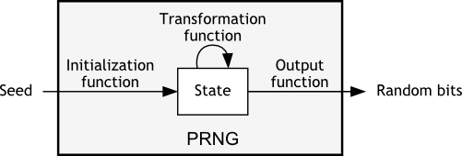
Generating Pseudo Random Number
The seed is an initial number of the pseudorandom number generator(PRNG) which is in fact fully deterministic. It returns a sequence of numbers that looks random enough for many purposes, but always generates the same sequence for given value.

Slide 33
Generating Pseudo Random Number
Python has a built-in module (random) that you can use to make random numbers.
Method | Description
seed() | Initialize the random number generator
getstate() | Returns the current internal state of the random number generator
setstate() | Restores the internal state of the random number generator
getrandbits() | Returns a number representing the random bits
randrange() | Returns a random number between the given range
randint() | Returns a random number between the given range

Slide 34
Generating Pseudo Random Number
Method | Description
choice() | Returns a random element from the given sequence
choices() | Returns a list with a random selection from the given sequence
shuffle() | Takes a sequence and returns the sequence in a random order
sample() | Returns a given sample of a sequence
random() | Returns a random float number between 0 and 1
uniform() | Returns a random float number between two given parameters

Slide 35
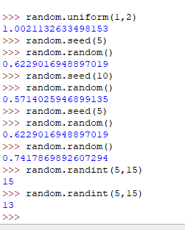
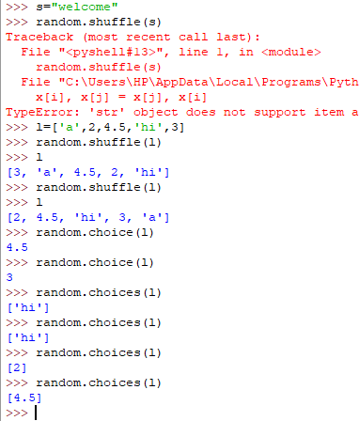
Generating Pseudo Random Number

Slide 36

Raising a Number to Large Power
Approach:
Find the prime factor of the exponent
Apply the power rule → (x^a)^{b}=x^{ab}
3. Calculate the exponent.
Eg:

